Slide 1
Digital Millennium Copyright Act (DMCA)
MCAS

Slide 2
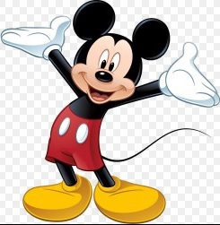
Copyright Law
Copyright law gives creators certain exclusive rights to their works, so that they can benefit financially from them.
These rights are limited in duration
‘Life’ plus 70/90/120 years
depending on type

Slide 3
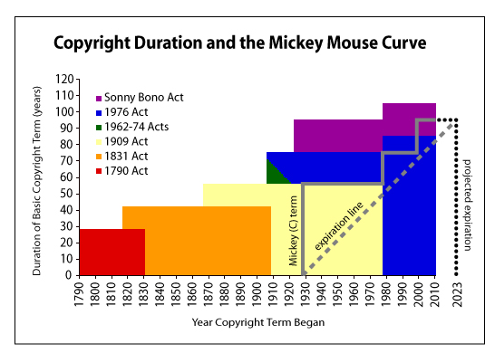

Slide 4
Copyright Law - Summary
The owner has exclusive right to reproduce the copyrighted work.
Distribute copies
Perform the work publicly
Display the work publicly

Slide 5
Copyright Law - Use
Copyright owners can grant Licenses to other persons/companies to make reproduction
Copy music/play music/sample music
Put on plays/musicals
Produce and sell copies
Use copies (software)

Slide 6
Copyright – Fair Use
In order to make sure that incentivizing and compensating creative works does not stifle the free exchange of ideas and opinions, we have “fair use.”
Fair use allows you to use copyrighted material without permission or payment for certain socially valuable purposes.
“. . . . for purposes such as criticism, comment, news reporting, teaching, scholarship, or research, is not an infringement of copyright.”

Slide 7
Digital Millennium Copyright Act (“DMCA”)
The DMCA is a 1998 law
The DMCA was implemented as part of the US’ obligations under the World Intellectual Property Organization Copyright Treaty.
New technologies (i.e. the internet) allowed people to more freely and easily transfer Intellectual Property.

Slide 8
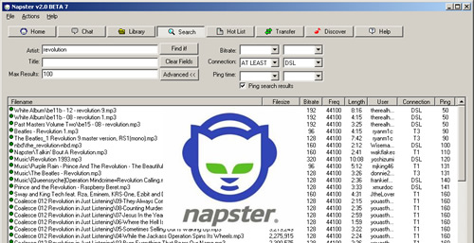

Slide 9
DMCA – Two Parts
Two important parts to DMCA:
Anti-circumvention provisions
Safe-harbor provisions

Slide 10
DMCA – Anti-Circumvention
Suppose, a Copyright holder puts protection software on its media or as part of its software.
(e.g. Digital Rights Management or “DRM”)
DRM restricts access to the intellectual property
E.g. you can’t make a copy or limited number of copies
So, a software “pirate” would use a program or some means to get around the DRM and copy the program.

Slide 11
DMCA – Anti-Circumvention
the DMCA prohibits three acts:
it prevents someone from circumventing protections that restrict “access” to a copyrighted work;
(2) it prevents someone from making, selling, or trafficking in a device that circumvents protections that restrict “access” to a copyrighted work; and
(3) it prevents someone from making, selling, or trafficking in a device that circumvents measures that protect “a right of a copyright owner.”

Slide 12
DMCA – Safe Harbor
The second important part of DMCA is the “Safe Harbor” provisions.
The SF protects online service providers (e.g. ISPs) against copyright infringement liability if they meet certain requirements.
Promptly block or remove material when receiving a notification – “Takedown notice”
Content Users can file a counter-notice.

Slide 13
https://www.youtube.com/watch?v=N1KfJHFWlhQ

Slide 14
Criminal Case Example
Criminal Cases under DMCA are rare
Person must break DMCA for purposes of commercial profit
Example:
William Silvius sold “mod” chips for video game consoles, such as Playstation, that override the consoles’ security software (called “jailbreaking”)
Convicted of selling Mod chips over the internet.
2 Years probation and $2,500 fine

Slide 15
Case example - Volkswagen
Last month, Volkswagen was caught faking emissions test results on its “Clean Diesel” cars.
The car’s sophisticated software designed for managing the car’s emissions was programmed to recognize when it was being tested for emissions.
When tested—it ran emissions regulation of the car properly
When not tested—it reverted to inferior pollution control, up to 40 times more pollution than legally allowed.

Slide 16
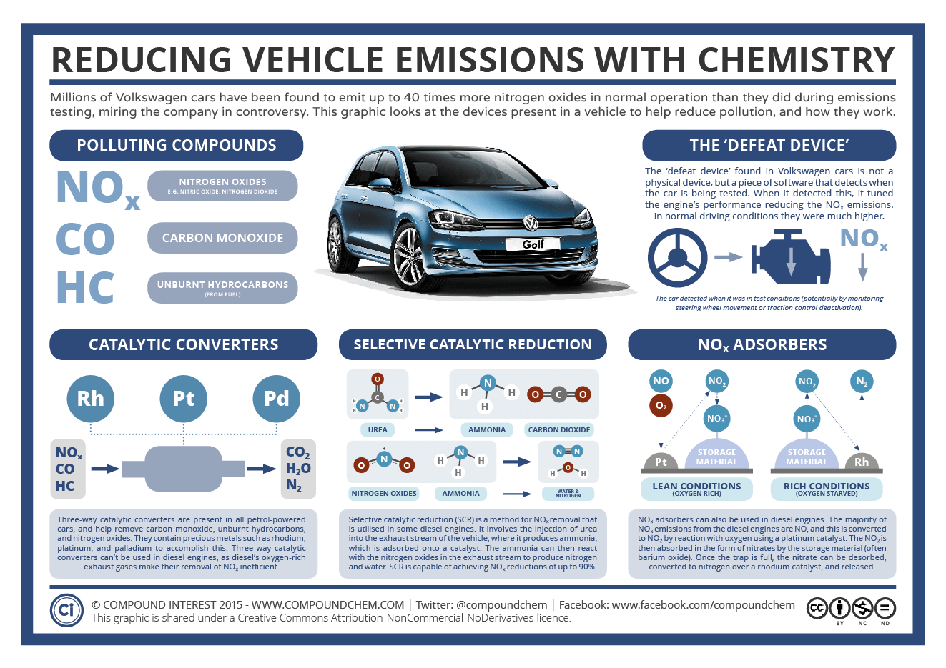

Slide 17
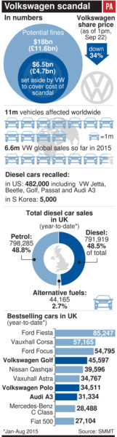

Slide 18
DMCA
Although you own a car, you do not own the software that manages it (you are a licensee).
The software on a car, including volkswagen’s cars, includes anti-circumvention measures.
Currently, it is not an exempt to circumvent the DRM on a car in order to conduct research.
In other words, the DMCA worked to shield VW’s illegal activity (indeed, enabled it).

Slide 19
2016 – Updated regulations
In October 2016, the US Copyright Office issued a ruling that security researchers may circumvent technological measures that control access to copyrighted works if it is done in good faith, in furtherance of controlled research, and on a consumer device.
The exemption covers all devices or machines primarily designed for use by individual consumers, such as toothbrushes, home thermostats, connected appliances, cars, and smart TVs and medical devices

